Slide 1
Talent Development
At HCL

Slide 2
Handling Excel Data

Slide 3
Excel Manipulation
Java provides different classes for File manipulation with Selenium.
We will be using Java IO package and Apache POI library.
POI stands for “Poor Obfuscation Implementation”

Slide 4
Downloading POI
URL - http://poi.apache.org/download.html
Download the latest version of POI.
Store it locally in your work station.
Unzip it.
In the Selenium Project, add all jar files from the POI root directory + lib directory and ooxml-lib directory (Use the option Add External Jar)

Slide 5
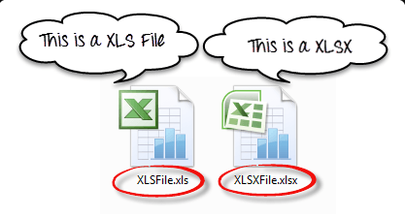
Types of excel

Slide 6
Read or Write Operation
To read and write to an excel, Apachi provides library POI.
The library can handle both “xls” and “xlsx” file format of excel.
List of Java Interface and Class in POI
XSSFWorkbook: Is a class representation of XLSX file.
HSSFWorkbook: Is a class representation of XLS file.
XSSFSheet: Is a class representing a sheet in an XLSX file.
HSSFSheet: Is a class representing a sheet in an XLS file.
XSSFRow: Is a class representing a row in the sheet of XLSX file
HSSFRow: Is a class representing a row in the sheet of XLS file.
XSSFCell: Is a class representing a cell in a row of XLSX file.
HSSFCell: Is a class representing a cell in a row of XLS file.

Slide 7
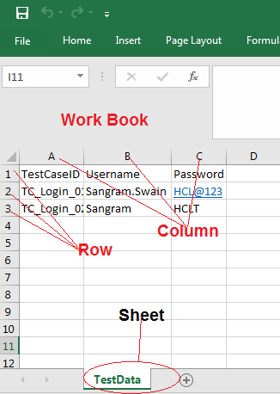
Excel Sheet

Slide 8
Code
Download the code from - https://github.com/sangramkswain/HCLPuneTraining
File name – ExcelManipulation.zip

